Slide 1
Performance Management Done Differently
Getting the Most from the Team
July 2017

Slide 2
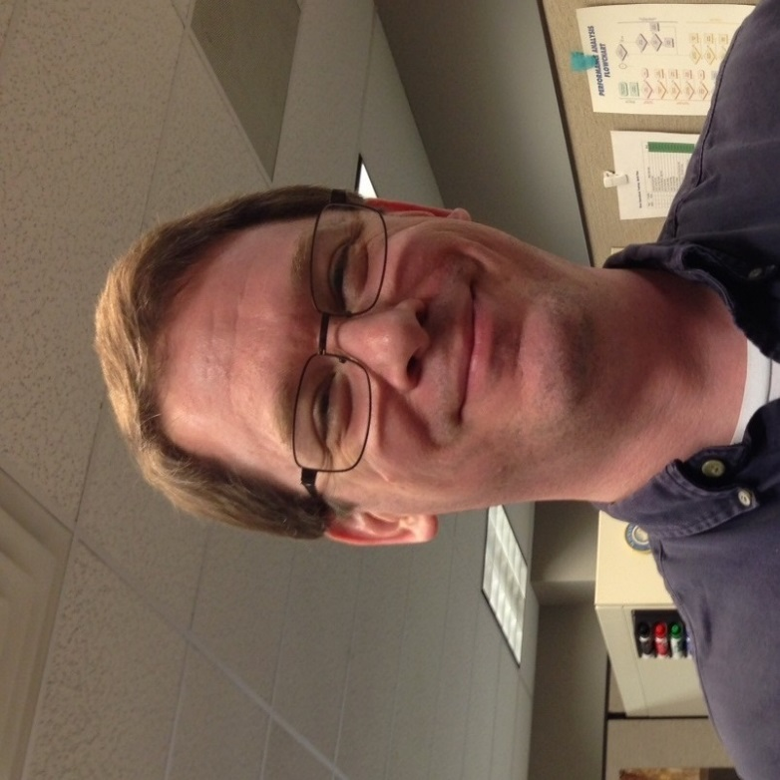
Your Presenter
Steve Semler
Chief Learning Architect / Talent Consultant
Author
HR Geek

Slide 3
What is Performance Management?

Slide 4
What is performance management?
Does any of this actually do any good?
Hmm…
Performance Appraisals?
Annual Evaluations?
Ratings?
Forced Ranking?
Peer Feedback?
No! These are not effective.

Slide 5
Performance Management
Purpose: Obtain the best possible performance from each individual and work group
Clearly links performance to expectations and goals
Tracks and reports on all meaningful results
Evaluates how results are obtained
Balances the what and the how
Gives performers a consistent way to close gaps between current and desired performance
Best separated from personnel decision making!

Slide 6
Why don’t these work?
Performance Appraisals
Annual Evaluations
Ratings
Forced Ranking
Peer Feedback

Slide 7
What should we do instead?
Give performers the information they need to manage their own performance
Get as close to real-time as possible
Make the indicators of results and behaviors (what and how) specific and measurable
Provide the human touch and reassurance very frequently (at least weekly)
But be sure to document exceptions—both positive and negative.

Slide 8
What works? Some tools…
Dashboards
Check-ins
Feedback
Coaching
The more performance metrics you can automate, the better people can see how they are doing.

Slide 9
Expectations
What is the person (or team) supposed to achieve, in terms of results?
How are they supposed to achieve those results, in terms of behaviors?
Your mission and values must be clearly included here!
If it is not measurable or observable, you cannot expect them to meet your expectations!
Expectations form one side of an agreement that management has with an employee. You must check for agreement.

Slide 10
Results (the what)
Goals
Targets
Standards
Amount of work produced
Efficiency
Effectiveness
Impact

Slide 11
Behaviors (the how)
Skills
Competencies
Attitudes
Methods/Processes
How people work together (or not)
Values in action
As a manager, you need to give people specific, behavioral feedback.
As an employee, you need to ask for, receive, and use feedback graciously.

Slide 12
Common Challenge: “Attitude”
Instructions:
With someone near your, share examples you have seen of a “poor attitude.”
Situation Hints:
Serving clients
Working with other employees
Supporting the team and organization
Define what a “good attitude” looks like in terms of results and behaviors.
Goal: Communicate this in terms of expectations.

Slide 13
Tool: Dashboards
Daily, weekly, monthly metrics in one place
“Let me see how I’m doing at a glance.”
If it can’t be automated, then set up a consistent way to collect and distribute the metrics
Everything must be meaningful to the mission

Slide 14
Tool: Check-ins
One-on-one and with the team
Weekly or bi-weekly
Short two-way review of results and behaviors
Suggested agenda:
Share/update the metrics
Ask for employee’s assessment
Give manager’s feedback
Provide coaching, if necessary
Look ahead at what is coming next
Make agreements to handle the upcoming performance needs

Slide 15
Tool: Feedback
Information the person doesn’t have about their performance
Backward-looking (reporting on observations)
Focus on what is being done well:
“I noticed… Keep doing this!”
Explain specifically where the person missed the mark. Include behavior and result:
“When you did…, this happened….”
You only have your point of view. Always ask for their perspective on what you observed.
“How did you feel that went?”

Slide 16
Tool: Coaching
Helps the person grow knowledge, skills, and abilities
Forward-looking (using feedback)
Mostly by asking open-ended questions
Uses “telling” and direction only:
When the person is stuck, or
Where there is a standard of results or behavior that the person must meet

Slide 17
What questions do you have?

Slide 18
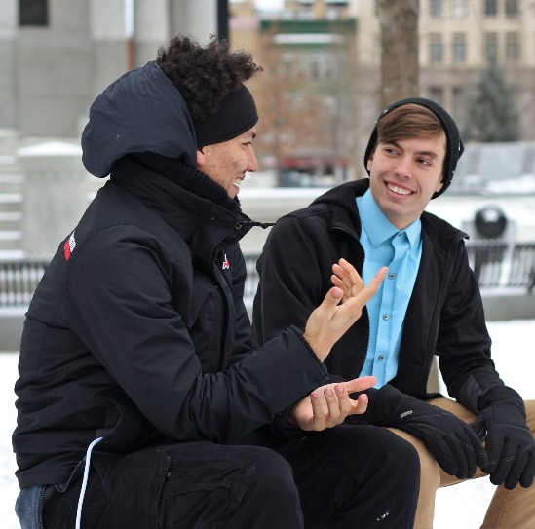
Practice
On your own and/or with someone near you, pick one to work on:
Expectations (what and how)
Dashboards
Check-ins
Feedback
Coaching
Make this something you can use back at the office.

Slide 19
What questions do you have?

Slide 20
Summary: Information they need
Separate performance management from personnel decisions
Give people the information they need to manage their own performance
The what and the how
Use the tools
People want to succeed!
Help them perform!

Slide 21
Resources
Your HR Manager
Advice: Talk with this person!
Managing Employee Performance (SHRM)
Search: shrm.org performance management
Society for Human Resource Managment (SHRM)
Site: www.shrm.org
This is the resource HR professionals use
steve@learningsim.com

